Slide 1
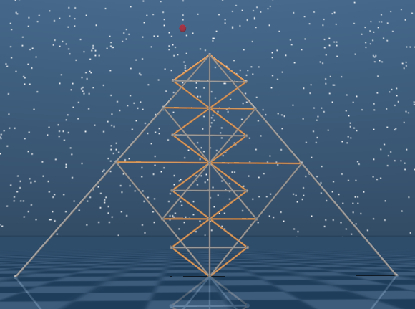
1
Bar length
1: 1m
2: 1m
3: 2m
2
3
bar
0.6m
0.8m

